Slide 1

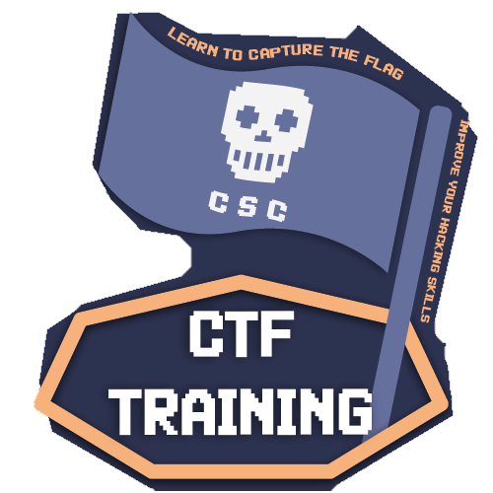



Reverse Engineering
CTF Training 2023

Slide 2

WHOAMI?
Saud Smadi [@smadi0x86]
★ President @CSCHTU
★ Second Year Cyber Security Student
★ Offensive Cyber Security
★ Security Automation (DevSecOps)
HOBBIES:
★ Developing & Breaking
★ Exploring Trending Tech

Slide 3


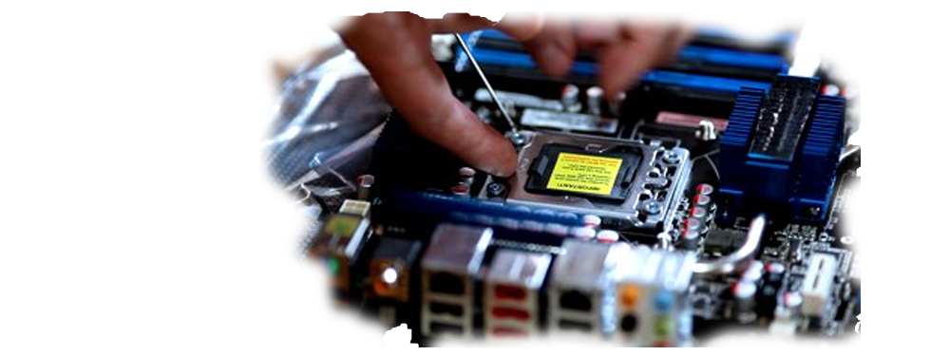
What is Reverse Engineering?
In simple terms Reverse Engineering refers to the process of deconstructing any engineered object to figure out the internal mechanisms.
- In hardware: Slicing electrical components and analyzing their logical gates
- In a restaurant: Tasting an amazing dish and trying to reproduce it at home

Slide 4







Why Reverse Engineering?
Cracking Games/Piracy
Enhance Development Skills/Malware Analysis
Hacktivism/Open-Source Supporter
For Fun/Establish existence

Slide 5
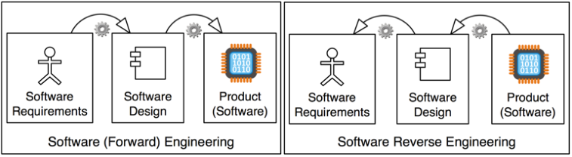
Reversing Software
In software the research object is a program - the machine code of an executable file
The goal is to understand what the program does and how (logic)

Slide 6
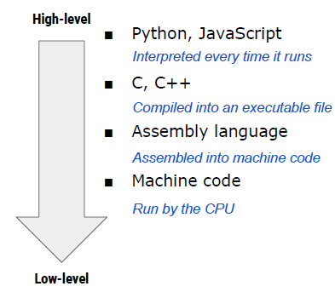
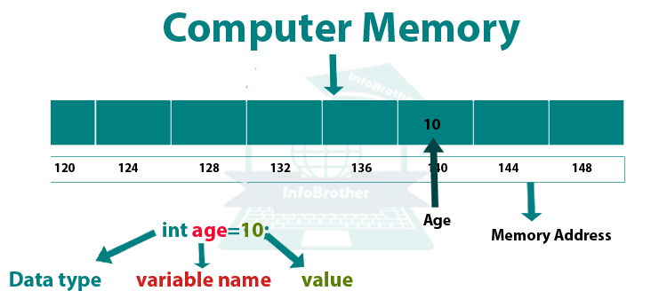
Levels Of Software Languages
Programming language levels describe how close a language is to the language the computer directly understands (machine code) or to human language.
1) Low-Level Languages (e.g., Assembly): Directly control the CPU and memory, closest to machine code, requires compilation.
2) High-Level Languages (e.g., Python, Java): More like human language, easier to learn, uses an interpreter or compiler to translate into machine code.
3) Memory Access: Low-level languages manipulate memory directly, while high-level languages manage memory automatically, making them safer but less efficient (slower to run).

Slide 7


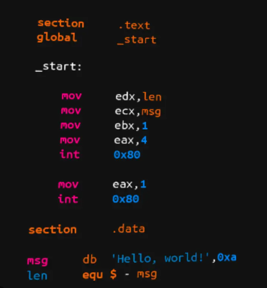
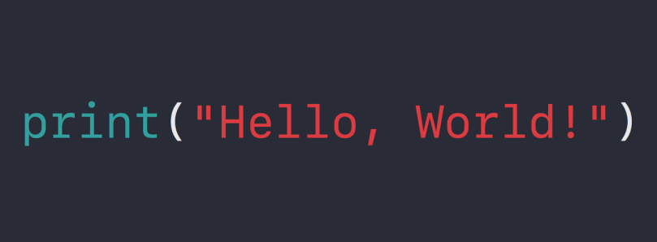
Hello World!

Slide 8
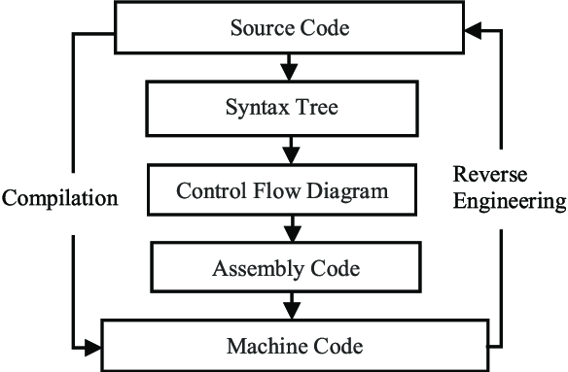








Reversing Binaries

Slide 9
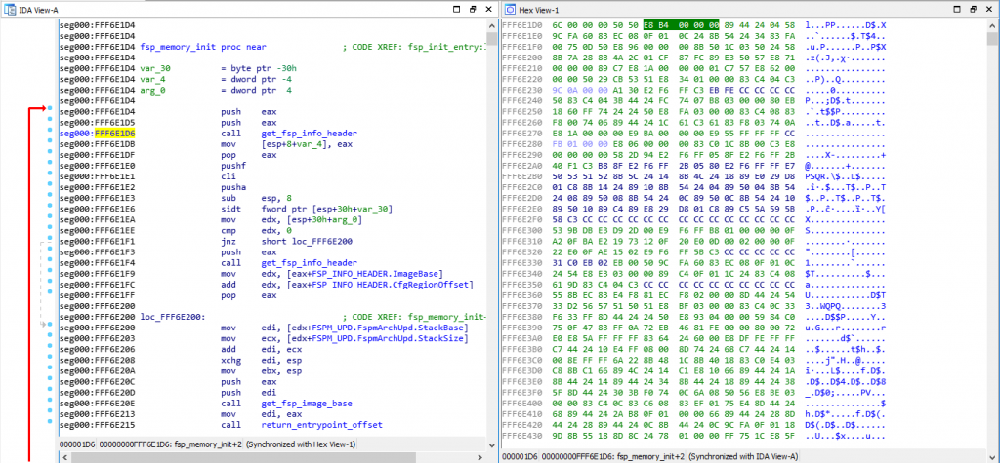
It’s not always easy
Don’t get overwhelmed

Slide 10
X86 Assembler Primer
“Everything Is Open Source If You Can Read Assembly”

Slide 11
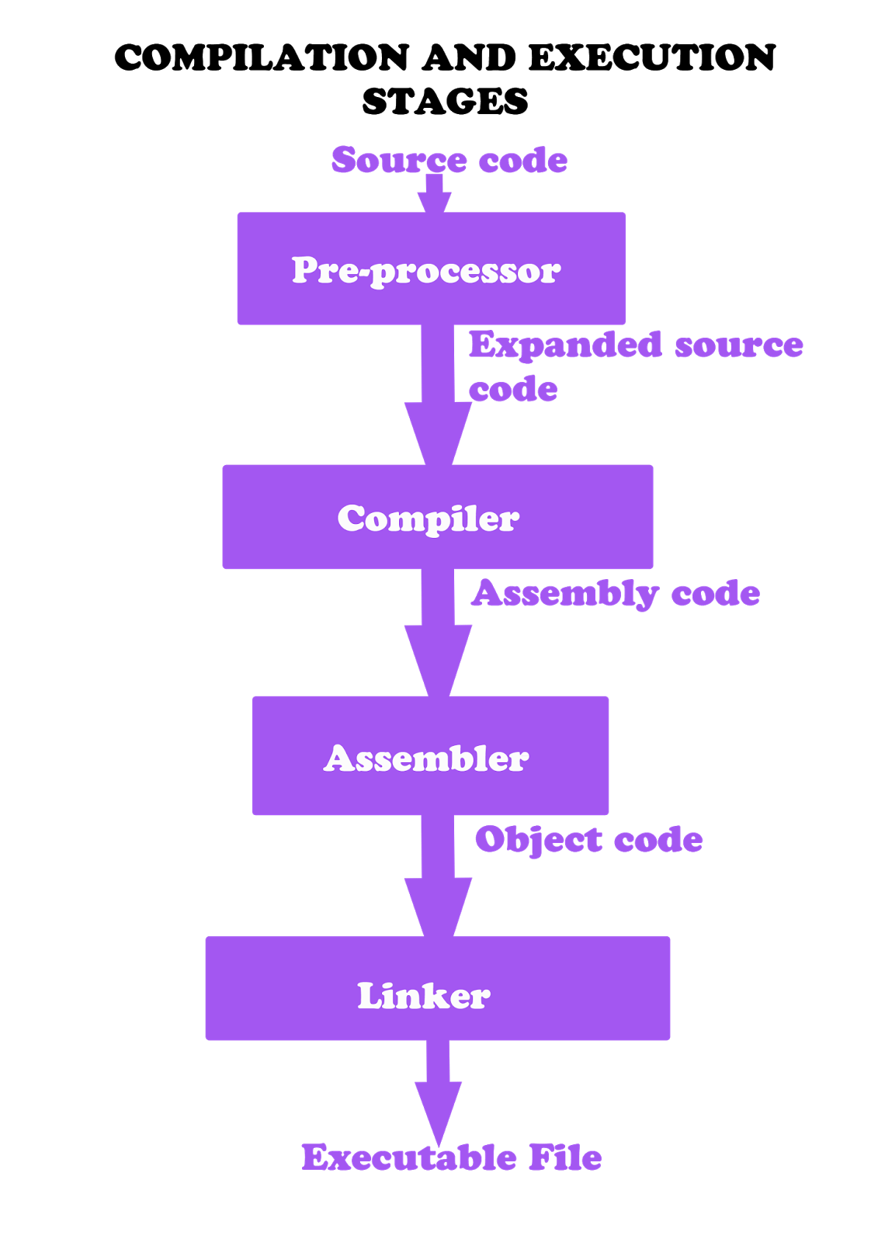
What is assembly?
Assembly language is a low-level programming language that provides direct instructions to the CPU, closely mirroring the CPU's machine code (01).
1) Direct CPU Commands: Assembly language directly tells the CPU what to do and controls how data is used and stored.
2) CPU-Specific Syntax: It uses a special syntax that varies depending on the type of CPU.
3) Varied for Different Architectures: Different computer architectures require different assembly languages.
4) Efficient but Complex: It's fast and efficient but more difficult to learn and use compared to higher-level languages.

Slide 12
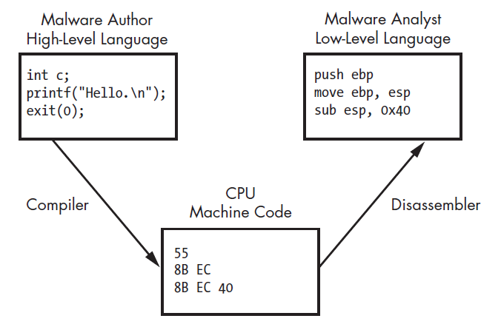
Compilation & Disassembly
1) The program author writes code in some high-level language, say C.
2) The C code is compiled into machine code - a series of bytes that the CPU understands.
3) The researcher usually has no access to the C source code, only to the bytes of machine code.
4) To make life easier, a disassembler translates these bytes into an easier-to-read textual representation.
RE

Slide 13
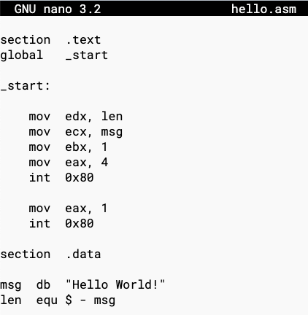




X86 ASM Intel Syntax
eax
The GNU Project used AT&T syntax, while nasm project uses intel syntax
%eax

Slide 14
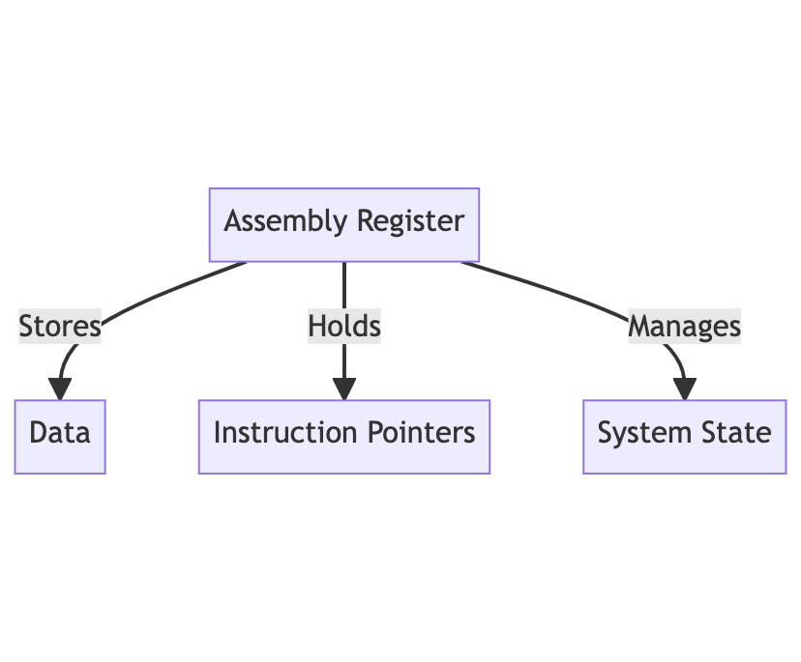
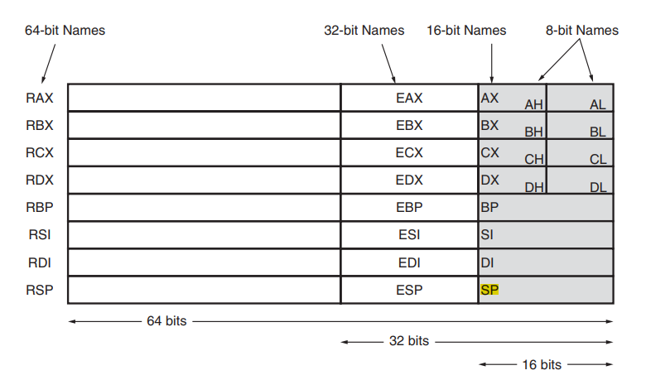

What are x86 registers?
A register can be thought of as a special memory location in the CPU.

Slide 15

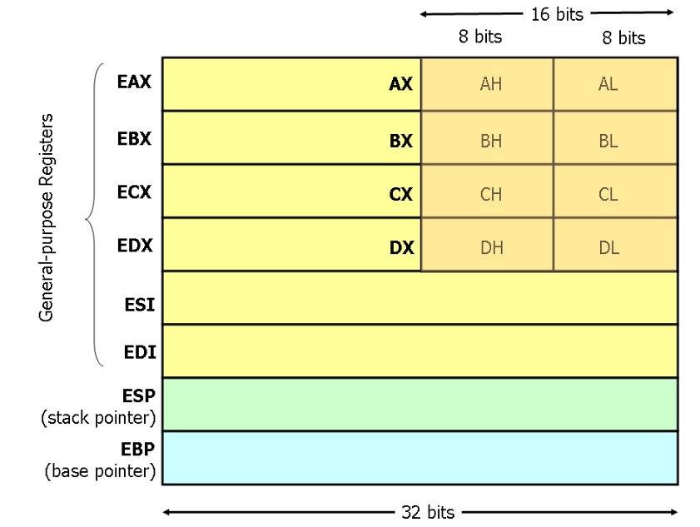
General Purpose Registers & Instructions
We can do all possible assembly operations on registers like adding values, subtracting etc.
Note that you generally don’t need to know details, just basic knowledge so you can understand logic (instructions).

Slide 16
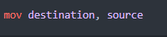
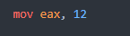
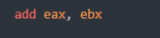
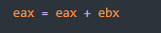
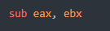
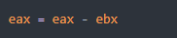
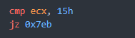
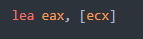
Basic ASM Operations
1) mov: moves values (or assigns values)
2) add/sub: Adds or subtracts values
3) cmp: Used for comparing values.
4) lea: This is like mov but instead of copying the value it copies the address.
Notes:
Cmp It acts as an if statement, if the compare returns 0 it means they are equal and then we jump to 0x7eb address (jz = jump if zero)

Slide 17
Quiz
What does each of the following instructions do? (answers are in the next slides)
mov eax, ebx
mov eax, 0x42
mov eax, [0x4037c4]
mov eax, [ebx]
mov eax, [ebx+esi*4]
Notes:
Cmp It acts as an if statement, if the compare returns 0 it means they are equal and then we jump to 0x7eb address (jz = jump if zero)

Slide 18
Quiz
What does each of the following instructions do? (answers are in the next slides)
mov eax, ebx move what’s in ebx to eax
mov eax, 0x42
mov eax, [0x4037c4]
mov eax, [ebx]
mov eax, [ebx+esi*4]
Notes:
Cmp It acts as an if statement, if the compare returns 0 it means they are equal and then we jump to 0x7eb address (jz = jump if zero)

Slide 19
Quiz
What does each of the following instructions do? (answers are in the next slides)
mov eax, ebx move what’s in ebx to eax
mov eax, 0x42 move 0x42 to eax
mov eax, [0x4037c4]
mov eax, [ebx]
mov eax, [ebx+esi*4]
Notes:
Cmp It acts as an if statement, if the compare returns 0 it means they are equal and then we jump to 0x7eb address (jz = jump if zero)

Slide 20
Quiz
What does each of the following instructions do? (answers are in the next slides)
mov eax, ebx move what’s in ebx to eax
mov eax, 0x42 move 0x42 to eax
mov eax, [0x4037c4] move what’s in address 0x4037c4 to eax
mov eax, [ebx]
mov eax, [ebx+esi*4]
Notes:
Cmp It acts as an if statement, if the compare returns 0 it means they are equal and then we jump to 0x7eb address (jz = jump if zero)

Slide 21
Quiz
What does each of the following instructions do? (answers are in the next slides)
mov eax, ebx move what’s in ebx to eax
mov eax, 0x42 move 0x42 to eax
mov eax, [0x4037c4] move what’s in address 0x4037c4 to eax
mov eax, [ebx] move what’s in the address in ebx to eax
mov eax, [ebx+esi*4]
Notes:
Cmp It acts as an if statement, if the compare returns 0 it means they are equal and then we jump to 0x7eb address (jz = jump if zero)

Slide 22
Quiz
What does each of the following instructions do? (answers are in the next slides)
mov eax, ebx move what’s in ebx to eax
mov eax, 0x42 move 0x42 to eax
mov eax, [0x4037c4] move what’s in address 0x4037c4 to eax
mov eax, [ebx] move what’s in the address in ebx to eax
mov eax, [ebx+esi*4] move what’s in address ebx+esi*4 to eax
Notes:
Cmp It acts as an if statement, if the compare returns 0 it means they are equal and then we jump to 0x7eb address (jz = jump if zero)

Slide 23
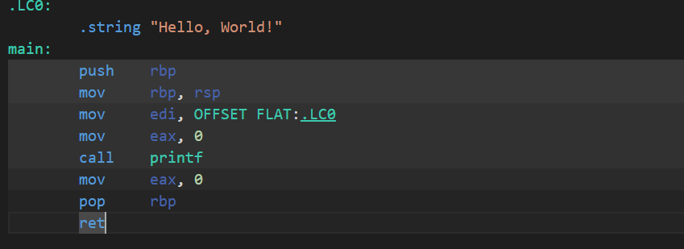
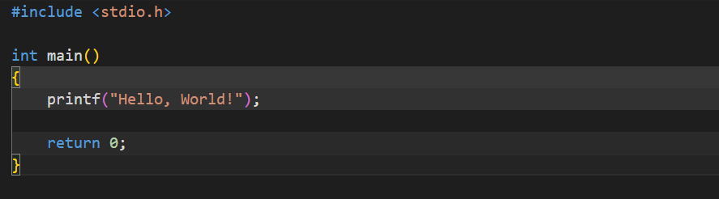
C Language vs x86 Assembly
https://godbolt.org/
Most of the time, there are a lot of initialization useless instructions that won’t be useful for us. What we are interested in is the “call” instruction which shows logic.

Slide 24
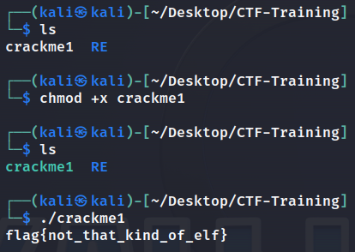
Handling Reverse Engineering Challenges
So, you downloaded the binary file, the question begins here, what’s next?
file command: Gives information about file
chmod +x command: Makes files able to run

Slide 25
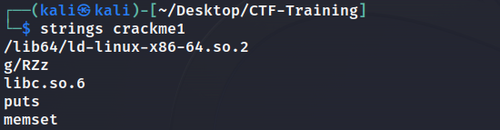
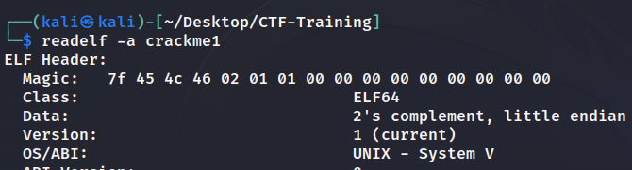
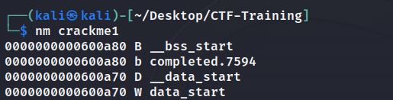
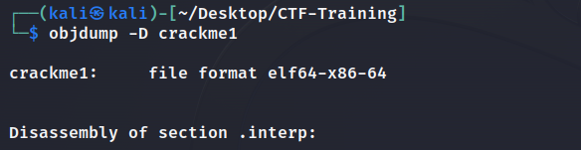
Static Analysis Of Binaries
strings: Extracts human-readable text from files
readelf: Examine elf file strucuture
objdump: Disassemble files
nm: Lists symbols in files

Slide 26
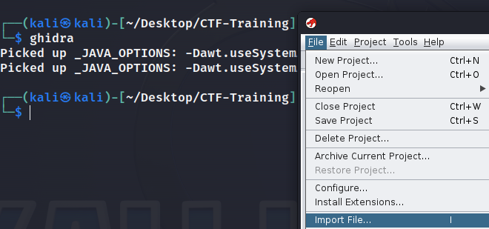

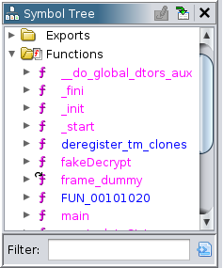
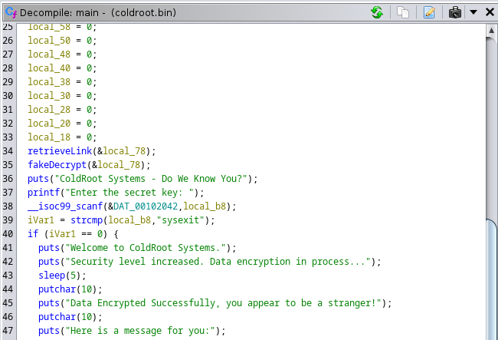
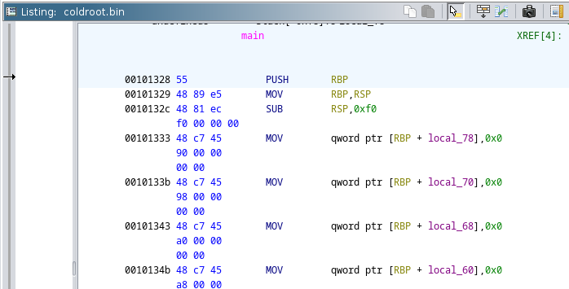
Static Analysis Of Binaries
ghidra: Reverse engineering tool that disassemble, decompile and provide useful insights

Slide 27
Dynamic Analysis Of Binaries
Did static analysis and got nothing? Maybe running/debugging the binary will reveal hidden stuff!
The most common tools for dynamic analysis are:
GDB: Debugger for analyzing
ltrace: Traces Library Function Calls
strace: Traces system calls

Slide 28
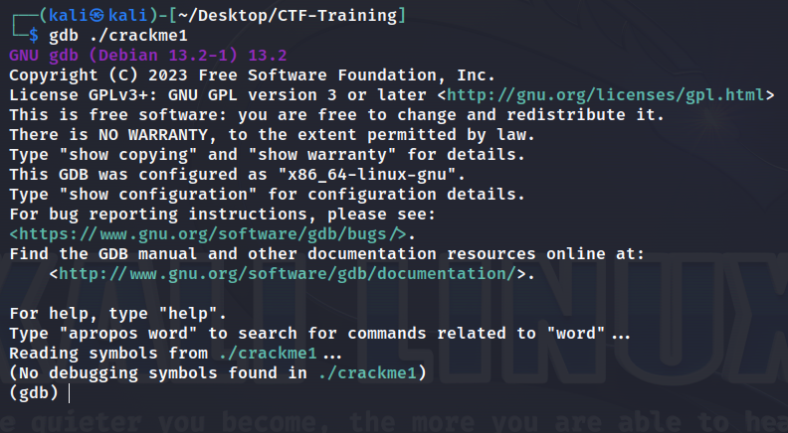
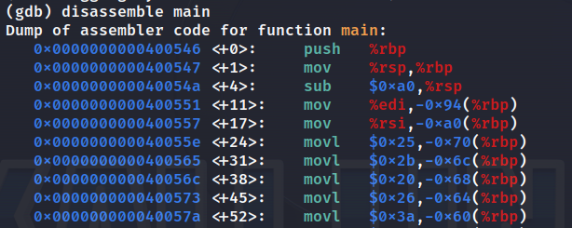
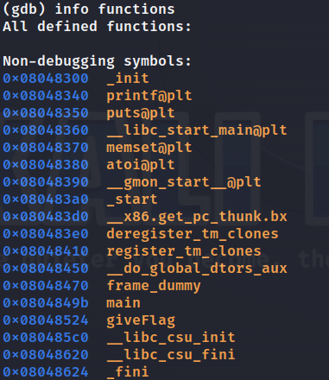
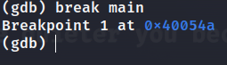
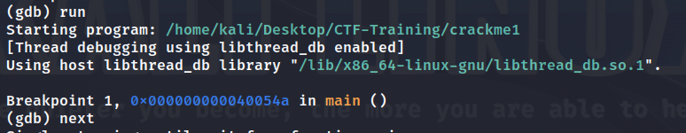
Dynamic Analysis: GNU Debugger
Run GDB:
Disassemble function:
Show Functions:
Break/Next Run:

Slide 29
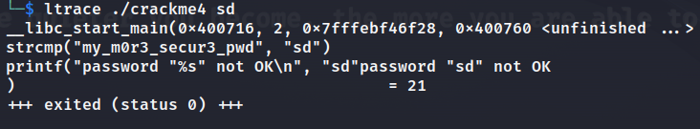
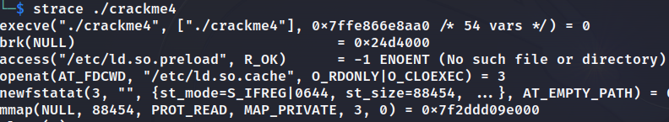
Dynamic Analysis: Ltrace & Strace
When you run strings command, you might see a “strcmp” library function, which mainly compares real flag/password with your input.
Ltrace:
Strace:
Note: Before using gdb/ghidra, its worth doing these checks to find any hints and save time.

Slide 30
Any Questions?

Slide 31

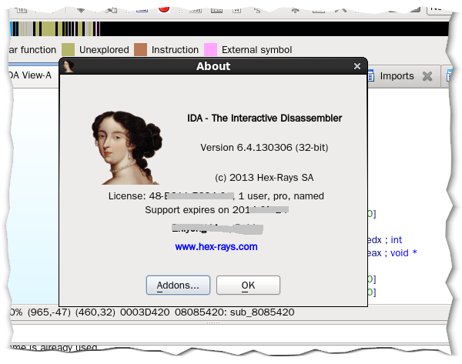
Lab 101: ColdRoot
https://github.com/Cyber-Security-Club-HTU/CTF-Training/tree/main/2023/Reverse-Engineering/Lab

Slide 32






